Slide 2
Haste Makes Waste: Don't Ruin Your Reputation with Hasty Regression
Dr. Steven C. Myers, The University of Akron
Steven Myers is an economist, educator in applied econometrics and an evangelist for economists in data science. He is the 2019 SAS Distinguished Educator. He specializes in combining economic and business acumen with rigorous statistical and programming techniques to solve problems and relate solutions to business leaders. He taught and mentored SAS programming, data handling, statistics and applied econometrics for over 40 years. He is a recovering CIO and is Associate Professor Emeritus at The University of Akron serving on their adjust faculty.

Slide 3


Slide 4
How do you know if your data is lying to you?
The answer lies in following ethical applied econometric rules and being aware of and avoiding pitfalls in regression practice.
These essential skills are not typically taught in single-semester econometric (or regression) course.

Slide 5

What are the Ethical Process rules for Applied Econometrics?
Rule 1: | Use common sense and economic reasoning
Rule 2: | Avoid Type III errors
Rule 3: | Know the context
Rule 4: | Inspect the data
Rule 5: | Keep it sensibly simple
Rule 6: | Use the interocular trauma test
Rule 7: | Understand the costs and benefits of data mining.
Rule 8: | Be prepared to compromise
Rule 9: | Do not confuse statistical significance with meaningful magnitude
Rule 10: | Report a sensitive analysis
Steven Myers. “Ethics Rules in Applied Econometrics and Data Science,” Essay 85, Policy Implications, in Bill Franks (ed.). 97 Things About Ethics Everyone in Data Science Should Know. O’Reilly, 2020, pp. 231-233.

Slide 6
What are the Pitfalls to Regression Practice?
This presentation is part of a larger effort I call
Avoiding the Pitfalls in Regression Analysis
EconDataScience.com
1. Failure to understand why you are running the regression.
2. Failure to be a data skeptic and ignoring the data generating process.
3. Failure to examine your data before you regress.
4. Failure to examine your data after you regress.
5. Failure to understand how to interpret regression results.
6. Failure to model both theory and data anomalies, and to know the difference.
7. Failure to be ethical.
8. Failure to provide proper statistical testing
9. Failure to properly consider causal calculus
10. Failure to meet the assumptions of the classical linear model.

Slide 7
Pitfall #7. Failure to Be ethical

Slide 8
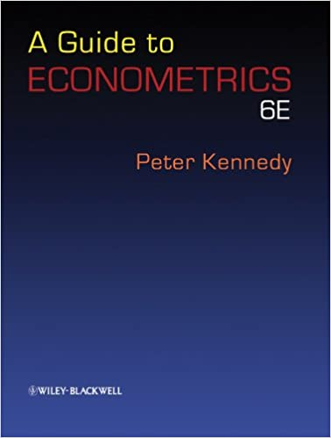
“… my opinion is that regardless of teachability, we have a moral obligation to inform students of these rules, and , through suitable assignments, socialize them to incorporate them into the standard operating procedures they follow when doing empirical work.… (I) believe that these rules are far more important than instructors believe and that students at all levels do not accord them the respect they deserve.”
Kennedy, Peter E. (2002) “Sinning in the Basement: What are the rules? The Ten Commandments of Applied Econometrics.” Applied Econometrics, Blackwell Publishers Ltd, pp.571-2.

Slide 9
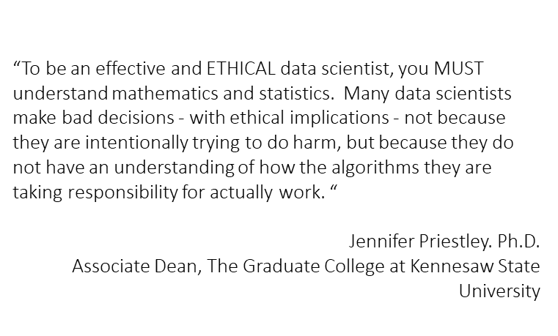

Slide 10
Pitfall #6. Failure to model theory and data anomalies and know the difference.

Slide 11
Business problem:
What was the value of a policy change, D, on our outcome metric, tax revenue, Y?
Articulate the problem:
Modeling theory:
Is the trend of our metric, Y, changed positively or negatively by our
measure of the policy/intervention, D?
H₀: An intervention that begins in T=8 has no effect on the trend line of Y.
H₁: An intervention at T=8 changes the trend line of Y.
Data Anomalies:
The actual equation is nonlinear in variables and the intervention has no effect. That is, the natural nonlinear progression is why it may appear that the intervention D has an effect.

Slide 12
Set up the Data
Read the 14 observations from work.Y,
The policy variable, D, taking values of 0 for time periods 1-7 and values of 1 for time periods 8 to 14. There is no other data available,
Create and transform variables for testing, and
in this example only assume the data is clean.
DATA Y;
input Y @@;
datalines;
12.35 13.71 16.00 17.94 20.76 21.11 24.63
27.56 32.88 35.16 39.26 44.28 47.27 51.55;
run;
Data trdata;
set Y;
T=_N_; /* 1. create time variable. */
TSQ = T*T; /* 2. and time-squared value. */
if T>=8 then D=1; Else D=0; /* 3. Create binary policy variable */
DT = D*T; /* 4. create interaction of D and T. */
run;

Slide 13
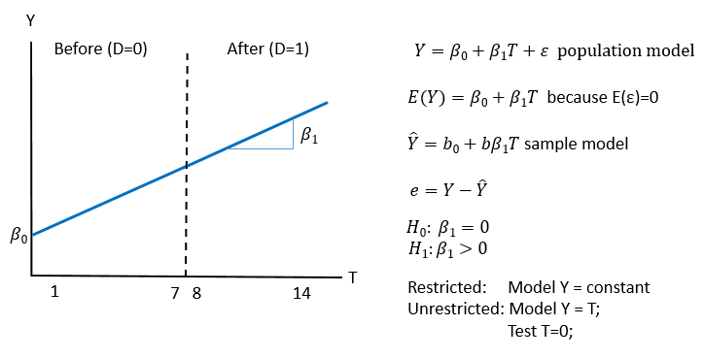
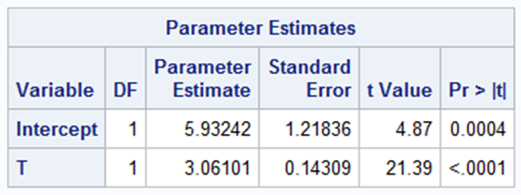
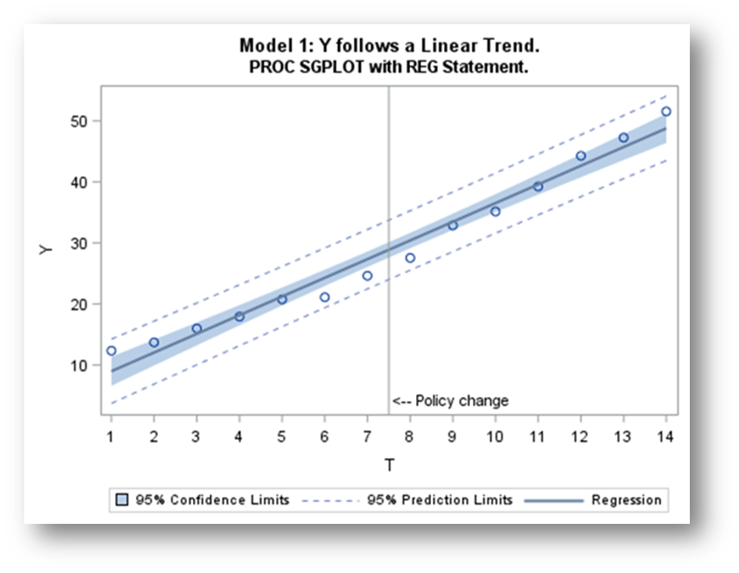
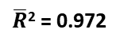
First regression: Establish the trend in the base model.
$\overline{R}$² = 0.972
ods graphics on;
Title1 'Regression Specifications - full sample' ;
PROC REG data=trdata;
var T TSQ D DT;
model_1: model Y = T;
run;

Slide 14
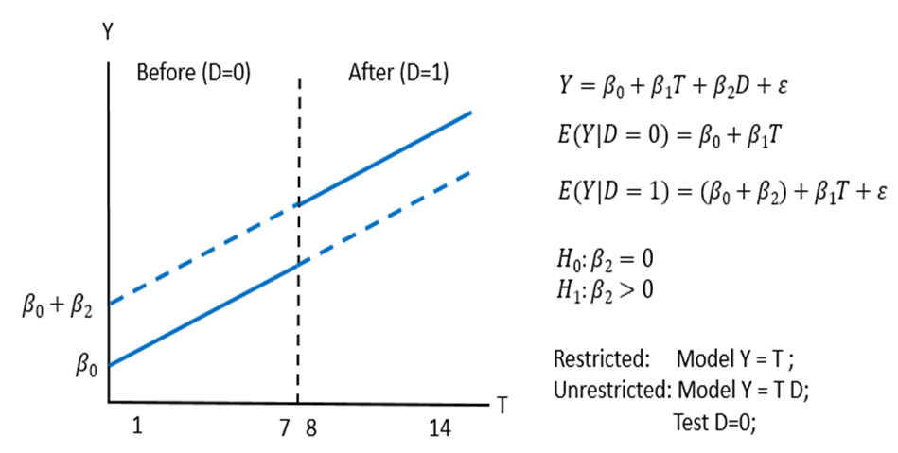
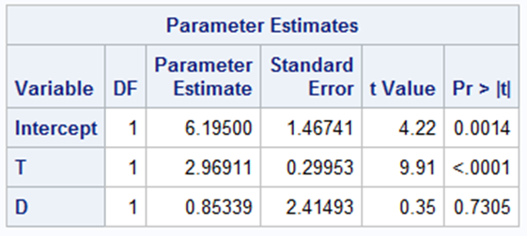
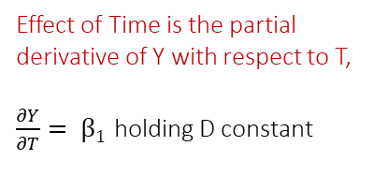
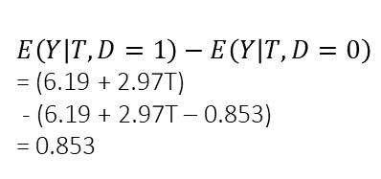
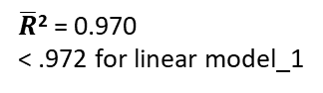
Hasty Regression: Just throw in a dummy variable.
title2 'Just throw in a dummy variable';
proc reg;
model_3: model y = t d;
run;
The intervention apparently
does not affect the outcome.
Y = 6.19 + 2.97T + e₁
Y = 6.19 + 2.97T + 0.853D + e₂
Effect of D is the difference
in the expected values
$$E\left(Y | T,D=1\right)−E\left(Y | T,D=0\right)$$
= (6.19 + 2.97T)
- (6.19 + 2.97T – 0.853)
= 0.853
Effect of Time is the partial derivative of Y with respect to T,
$\frac{∂Y}{∂T}= β1$ holding D constant
$\overline{R}$² = 0.970
< .972 for linear model_1
Notes:
Simple examples in our econometric courses suggest to students that any time you want to test an anonomly all you have to do is include a dummy variable.
This is simplistic and wrong
We need to model the process

Slide 15

Why isn’t hasty regression enough?
Garbage in,
Garbage out.
If you torture the data long enough, it will confess.
-Ronald Coase
So why not use automatic model selection?
How about use some thought?
Economics and common sense
Know the DGP and context
Clean the data before
Inspect the data after
Validate your specification and testing.
Regression selection process | winning model
Selection=adjRsq | T D DT
Selection=Stepwise | T TSQ
Selection=Forward | T TSQ D DT
Selection=Backward | T D DT
Selection=maxR | T TSQ D DT
Selection=minR | T TSQ D DT
Selection=CP | T D DT
https://xkcd.com/1838/

Slide 16
Lack of Proof, its all about rejection, not acceptance
H₀: β₂=0 The intervention had no effect
H₁: β₂≠0 The intervention had an effect
The problem with this is it is sensitive to model specification
 | The statistician can never “know” truth
The statistician’s decision | H₀ is true | H₀ is false
Rejects H₀ | α = P(reject H₀|H₀ is true) A wrong decision Convicting the innocent Type I Error | 1-β = P(reject H₀|H₀ is false) A correct decision Convicting the guilty Power of the test
Fails to Reject H₀ | 1-α = P(fail to reject H₀|H₀ is true) A correct decision Letting the innocent go free Confidence in the test | β = P(fail to reject H₀|H₀ is false) A wrong decision Letting the guilty go free Type II Error
The most damning are Type III errors which occur when you get the right answer to the wrong question (Kennedy, 2008).

Slide 17
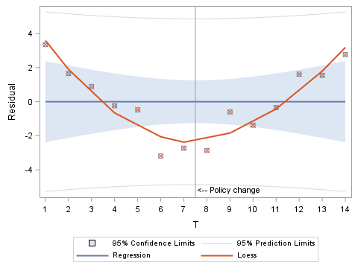
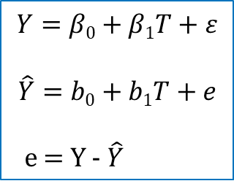
Look at the residuals in
the baseline regression
$$Y=β0+β1T+ε$$
$$\hat{Y}=b0+b1T+e$$
e = Y - $\hat{Y}$
Title2 'Examining the residuals to the linear trend model.';
PROC REG data=trdata;
model_1R: model Y = T;
output out=TR r=residual;
run;
PROC SGPLOT data=TR;
reg x=T y=residual / degree=1 CLM CLI CLMTRANSPARENCY=.5;
loess x=T y=residual / interpolation=linear degree=2;
&xref;
run;

Slide 18
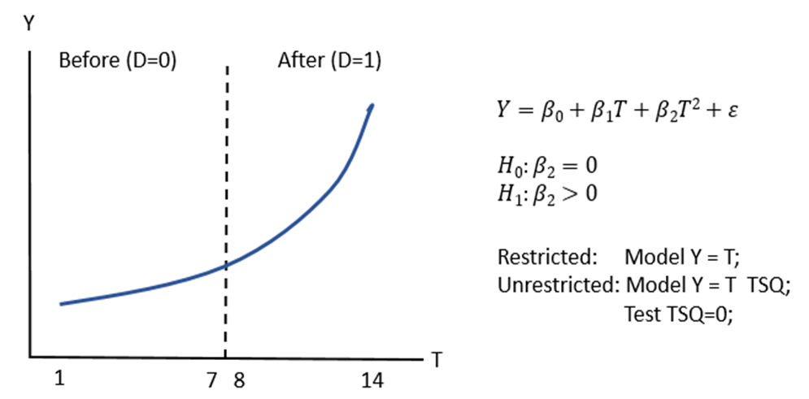
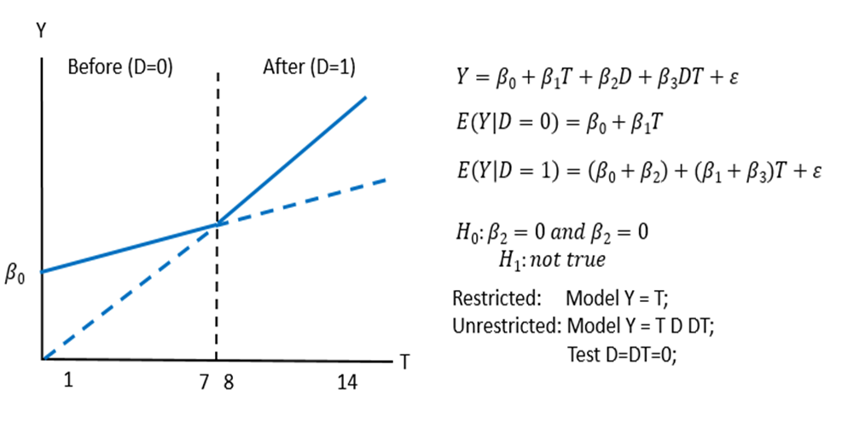
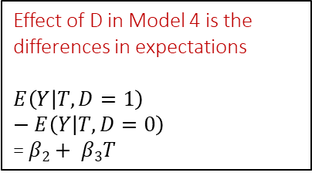
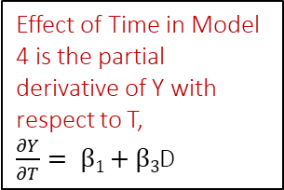
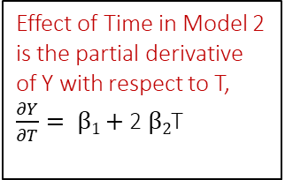
Two models are suggested by analysis
title2 'Quadratic Model';
model_2: model Y = T TSQ;
Quadratic: test tsq=0;
run;
Effect of Time in Model 2 is the partial derivative of Y with respect to T,
$\frac{∂Y}{∂T}= β1+$ 2 $β2$T
title2 'Structural break model';
model_4: model Y = T D DT;
Structural_break: test D=DT=0;
run;
Effect of Time in Model 4 is the partial derivative of Y with respect to T,
$\frac{∂Y}{∂T}= β1+$ $β3$D
Effect of D in Model 4 is the differences in expectations
$$E\left(Y | T,D=1\right)−E\left(Y | T,D=0\right)$$
= $β2+ β3T$

Slide 19
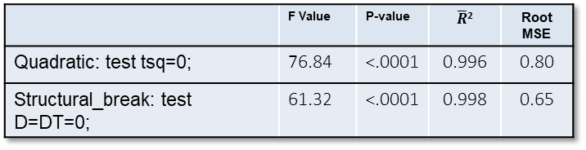
Testing both models against the base model
title2 'Quadratic Model';
model_2: model Y = T TSQ;
Quadratic: test tsq=0;
run;
 | F Value | P-value | $\overline{R}$² | Root MSE
Quadratic: test tsq=0; | 76.84 | <.0001 | 0.996 | 0.80
Structural_break: test D=DT=0; | 61.32 | <.0001 | 0.998 | 0.65
Arghhhhh: Both models are valid.
title2 'Structural break model';
model_4: model Y = T D DT;
Structural_break: test D=DT=0;
run;

Slide 20
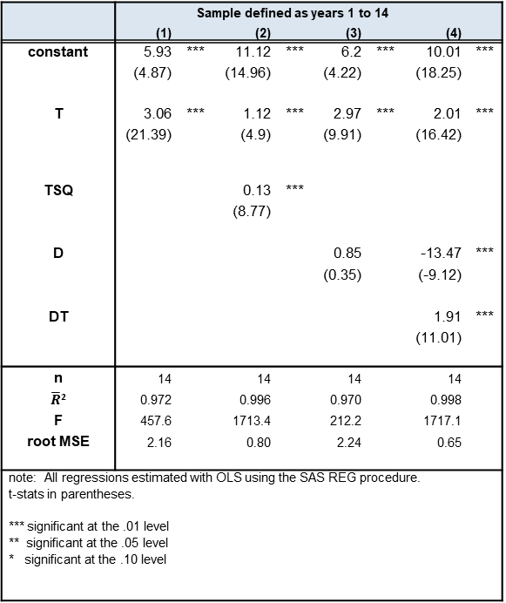
Both models perform very well.
Both models 2 and 4 reject the null hypothesis of a linear trend.
Both the quadratic model and structural break model are “acceptable.”
 | Sample defined as years 1 to 14
 | (1) |  | (2) |  | (3) |  | (4)
constant | 5.93 | *** | 11.12 | *** | 6.2 | *** | 10.01 | ***
 | (4.87) |  | (14.96) |  | (4.22) |  | (18.25)
T | 3.06 | *** | 1.12 | *** | 2.97 | *** | 2.01 | ***
 | (21.39) |  | (4.9) |  | (9.91) |  | (16.42)
TSQ |  |  | 0.13 | ***
 |  |  | (8.77)
D |  |  |  |  | 0.85 |  | -13.47 | ***
 |  |  |  |  | (0.35) |  | (-9.12)
DT |  |  |  |  |  |  | 1.91 | ***
 |  |  |  |  |  |  | (11.01)
n | 14 |  | 14 |  | 14 |  | 14
$\overline{R}$² | 0.972 |  | 0.996 |  | 0.970 |  | 0.998
F | 457.6 |  | 1713.4 |  | 212.2 |  | 1717.1
root MSE | 2.16 |  | 0.80 |  | 2.24 |  | 0.65
note: All regressions estimated with OLS using the SAS REG procedure. t-stats in parentheses. *** significant at the .01 level ** significant at the .05 level * significant at the .10 level
These are called nested hypothesis. The null hypothesis
Is a subset of the model being tested.
Model 1 is the restricted model compared to the unrestricted models 2 and 4.
 | F Value | P-value
Quadratic: test tsq=0; | 76.84 | <.0001
Structural_break: test D=DT=0; | 61.32 | <.0001

Slide 21
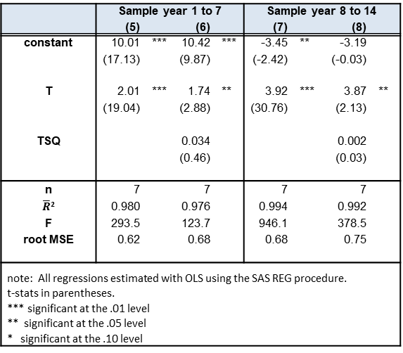
How do the models fit in the before and after period?
If the quadratic model ruled, then it would exist in the sub samples and it does not!
There was a structural break!
title2 ‘Before Sample, T=1,...,7';
PROC reg data=work.trdata;
model_5: model Y = T ;
model_6: model Y = T TSQ ;
where D=0;
run;
title2 ‘After Sample, T=8,..., 14';
PROC reg data=work.trdata;
model_7: model Y = T ;
model_8: model Y = T TSQ ;
where D=1;
run;
 | Sample year 1 to 7 |  |  |  | Sample year 8 to 14
 | (5) |  | (6) |  | (7) |  | (8)
constant | 10.01 | *** | 10.42 | *** | -3.45 | ** | -3.19
 | (17.13) |  | (9.87) |  | (-2.42) |  | (-0.03)
T | 2.01 | *** | 1.74 | ** | 3.92 | *** | 3.87 | **
 | (19.04) |  | (2.88) |  | (30.76) |  | (2.13)
TSQ |  |  | 0.034 |  |  |  | 0.002
 |  |  | (0.46) |  |  |  | (0.03)
n | 7 |  | 7 |  | 7 |  | 7
$\overline{R}$² | 0.980 |  | 0.976 |  | 0.994 |  | 0.992
F | 293.5 |  | 123.7 |  | 946.1 |  | 378.5
root MSE | 0.62 |  | 0.68 |  | 0.68 |  | 0.75
note: All regressions estimated with OLS using the SAS REG procedure. t-stats in parentheses. *** significant at the .01 level ** significant at the .05 level * significant at the .10 level

Slide 22
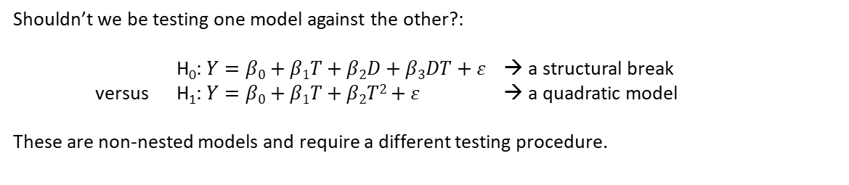
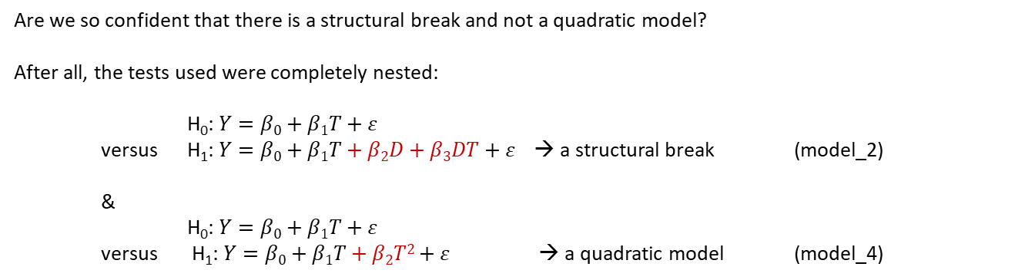
Non-nested hypothesis testing
Are we so confident that there is a structural break and not a quadratic model?
After all, the tests used were completely nested:
H₀: $Y=β0+β1T+ε$
versus H₁: $Y=β0+β1T+β2D+β3DT+ε$ → a structural break (model_2)
&
H₀: $Y=β0+β1T+ε$
versus H₁: $Y=β0+β1T+β2T2+ε$ → a quadratic model (model_4)
Shouldn’t we be testing one model against the other?:
H₀: $Y=β0+β1T+β2D+β3DT+ε$ → a structural break
versus H₁: $Y=β0+β1T+β2T2+ε$ → a quadratic model
These are non-nested models and require a different testing procedure.

Slide 23
Non-nested hypothesis testing code
Title1 'Non-nested hypothesis - J-test';
Proc reg data=trdata;
model_2: model Y = T TSQ;
output out=Mquad p=Yquadhat;
run;
Proc reg data=trdata;
model_4: model Y = T D DT;
output out=Mbreak p=Ybreakhat;
run;
Proc reg data=Mbreak;
model_2A: model Y = T TSQ Ybreakhat;
run;
Proc reg data=Mquad;
model_4A: model Y = T D DT Yquadhat;
run;
Title1 'Non-nested hypothesis test, super model, F-test';
Proc reg data=trdata;
model_4A: model Y = T TSQ D DT;
quad: test TSQ = 0;
structural_break: test D=DT=0;
run;

Slide 24
Four tests all reject ‘quadratic’ in favor of the ‘structural break’ model.
Parameters unique to the ‘quadratic’ model are not rejected from zero.
Conclusion: the ‘break’ model is not rejected.
The ‘break’ model contributes significantly to the explanation of the ‘quadratic’ model.
Conclusion: reject the ‘quadratic’ model
 | Variance encompassing test |  |  |  |  |  |  |  |  |  | Mean encompassing test
 | Quadratic |  | J-TEST |  | Break |  | J-TEST |  |  |  |  | F-TEST
constant | 11.12 | *** | 1.26 |  | 10.01 | *** | 8.67 | *** |  |  |  | 10.23 | ***
 | (14.96) |  | (-0.33) |  | (18.25) |  | (2.22) |  |  |  |  | (12.01)
T | 1.12 | *** | 0.11 |  | 2.01 | *** | 1.71 | *** |  |  |  | 1.87 | ***
 | (4.9) |  | (0.25) |  | (16.42) |  | (1.94) |  |  |  |  | (4.26)
TSQ | 0.13 | *** | 0.02 |  |  |  |  |  |  |  |  | 0.02
 | (8.77) |  | (0.33) |  |  |  |  |  |  |  |  | (0.35)
D |  |  |  |  | -13.47 | *** | -11.56 | *** |  |  |  | -11.56 | **
 |  |  |  |  | (-9.12) |  | (-2.02) |  |  |  |  | (-2.02)
DT |  |  |  |  | 1.91 | *** | 1.66 | *** |  |  |  | 1.66
 |  |  |  |  | (11.01) |  | (2.19) |  |  |  |  | (2.19)
Y-prediction |  |  | 0.89 | ** |  |  | 0.14 |  |  |  | quad: test TSQ = 0; | F = 0.12
from other model |  |  | (2.61) |  |  |  | (0.35) |  |  |  | break: test D=DT=0; | F = 3.07 | *
n | 14 |  | 14 |  | 14 |  | 14 |  |  |  |  | 14
adj R-sq | 0.972 |  | 0.998 |  | 0.970 |  | 0.997 |  |  |  |  | 0.997
F | 457.6 |  | 1746.3 |  | 212.2 |  | 1181.4 |  |  |  |  | 1181.4
root MSE | 2.16 |  | 0.06 |  | 2.24 |  | 0.68 |  |  |  |  | 0.68
The ‘quadratic’ model contributes nothing to the explanation of the ‘break model.
Conclusion: fail to reject the ‘’break’ model
Parameters unique to the ‘break’ model are rejected from zero.
Conclusion: the ‘quadratic’ model is rejected.
note: All regressions estimated with OLS using the SAS REG procedure. T-stats in parentheses.
*** significant at the .01 level
** significant at the .05 level
* significant at the .10 level

Slide 25
J-test |  | F-test
Quadratic Model | Structural Break | Quadratic Model | Structural Break
“Acceptable” | “Acceptable” | “Acceptable” | “Acceptable”
 |  | “Acceptable” | “not Acceptable”
 |  | “not Acceptable” | “Acceptable”
 |  | “not Acceptable” | “not Acceptable”
“Acceptable” | “not Acceptable” | “Acceptable” | “Acceptable”
 |  | “Acceptable” | “not Acceptable”
 |  | “not Acceptable” | “Acceptable”
 |  | “not Acceptable” | “not Acceptable”
“not Acceptable” | “Acceptable” | “Acceptable” | “Acceptable”
 |  | “Acceptable” | “not Acceptable”
 |  | “not Acceptable” | “Acceptable”
 |  | “not Acceptable” | “not Acceptable”
“not Acceptable” | “not Acceptable” | “Acceptable” | “Acceptable”
 |  | “Acceptable” | “not Acceptable”
 |  | “not Acceptable” | “Acceptable”
 |  | “not Acceptable” | “not Acceptable”
Complete encompassing reconciliation of the
Mean Encompassing tests (J-test)
and the
Variance Encompassing Tests (F-test)

Slide 26
Ramsey misspecification tests (RESET) from SAS/ETS
proc autoreg data=trdata;
model_1: model y = T
/ reset;
run;
proc autoreg data=trdata;
model_2: model y = T TSQ
/ reset;
run;
proc autoreg data=trdata;
model_3: model y = T D
/ reset;
run;
proc autoreg data=trdata;
model_4: model y = T D DT
/ reset ;
run;
Model | P=2 | P=3 | P=4
1 Y=T Linear | Reject | Reject | Reject
2 Y=T TSQ Quadratic | Fail to reject | Fail to reject | Fail to reject
3 Y=T D Hasty Regression | Reject | Reject | Reject
4 Y=T D DT Structural break | Fail to reject | Fail to reject | Fail to reject

Slide 27
Use of automatic model selection in PROC REG
Regression selection process | winning model
Selection=adjRsq | T D DT
Selection=Stepwise | T TSQ
Selection=Forward | T TSQ D DT
Selection=Backward | T D DT
Selection=maxR | T TSQ D DT
Selection=minR | T TSQ D DT
Selection=CP | T D DT
Automatic selection leads to the
Structural break model 3 times
Quadratic model 1 time, and the
Super model 3 times.
Which to believe?

Slide 28
Conclusion: There is strong evidence of a structural break in the metric Y because of the intervention, D, as studied.
Visually, we liked two models on the entire sample and only the linear on the sub-samples.
Eight regressions were necessary to complete a testing strategy that convinced us that the structural break model was a better representation of the data.
We showed that a Hasty Regression led to a false conclusion, namely that D did not matter. This was the biggest lie in the data. [Not only did D have no effect in Model Y = T D; it also has no effect in Model Y = T TSQ D; either. Hasty regression lies whether you assume a base linear or nonlinear model in time. ]
The ‘quadratic model’ was tested against the ‘structural break’ model directly by the use of non-nested hypotheses: four tests were run and in each case the ‘quadratic model’ was found lacking.
A Ramsey test for misspecification was run on all models and found the structural break and quadratic models both “acceptable.”
Finally, automatic processes do not arrive at the same conclusion. Human critical thinking processes are critical for making sense of this data.

Slide 29
Thank you for watching!
Contact me at
Dr. Steven Myers myers@uakron.edu
LinkedIn: stevencmyers
Website: EconDataScience.com

